Slide 1
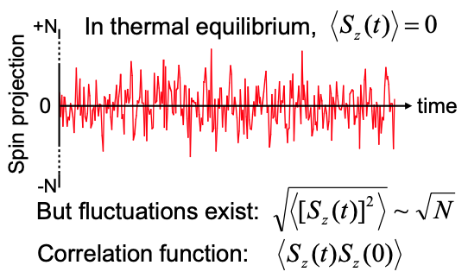
“聆听”半导体中的电子自旋噪声
“Listening” to the spin noise of electrons in semiconductors
杨鲁懿
清华大学物理系
luyi-yang@mail.tsinghua.edu.cn

Slide 2
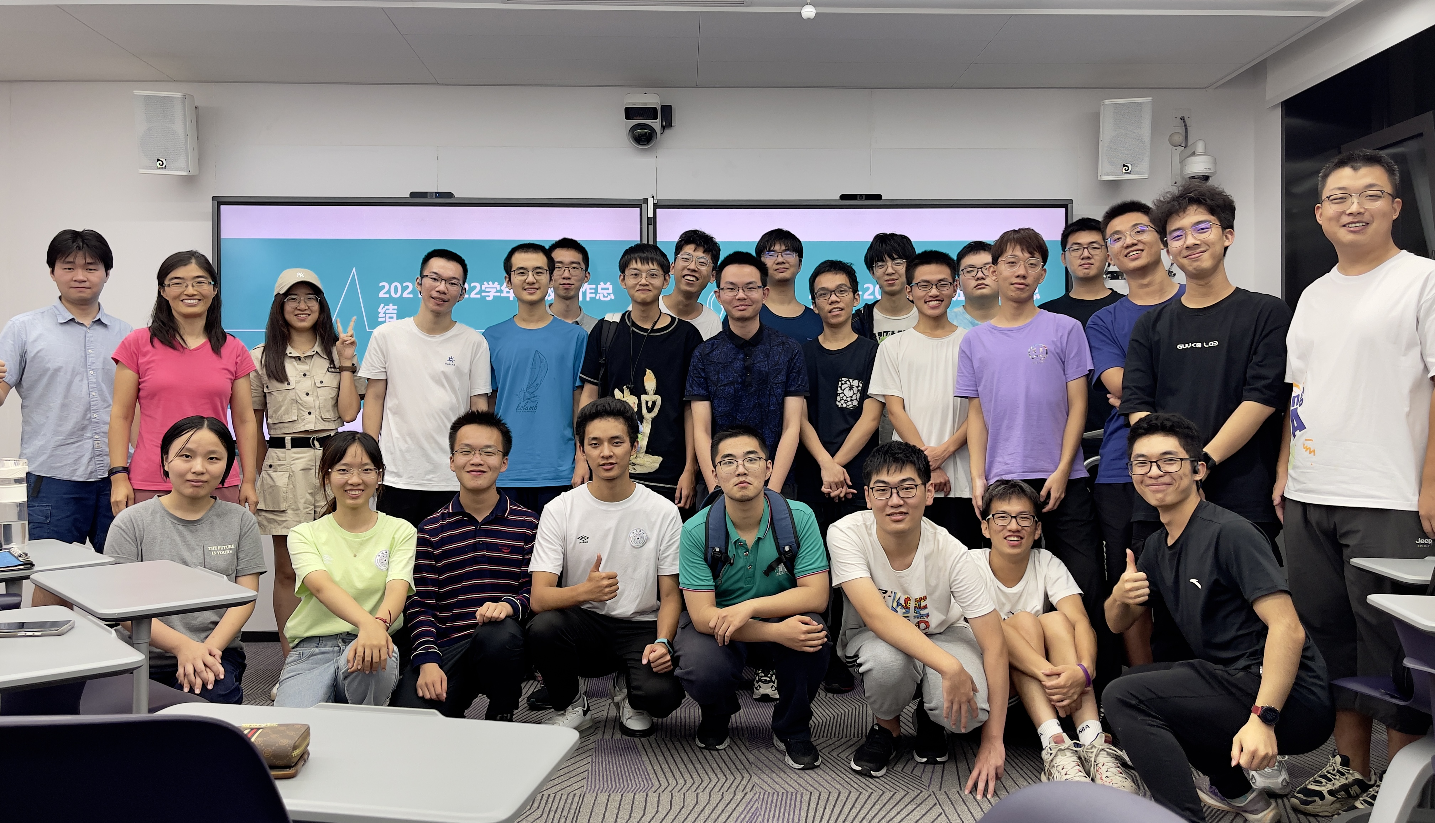

CV
2003-2007 清华大学 学士
2007-2013 美国加州大学伯克利分校 博士
2013-2016 美国国家强磁场实验室Los Alamos 博士后
2016-2019 加拿大多伦多大学物理系 助理教授
2019.9-今 清华大学物理系 副教授

Slide 3
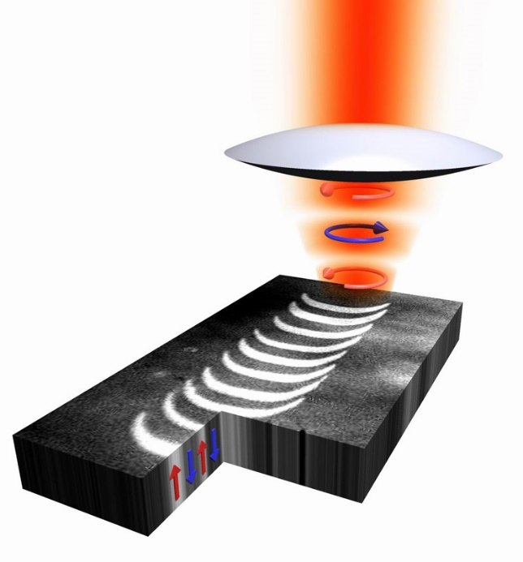
Research Area
应用和发展
先进光学技术
凝聚态物理
Please visit http://info.phys.tsinghua.edu.cn/yanglab/ for more information.

Slide 4

事情是这样的…
续老师的课超赞哦!
那今年大作业选这个话题吧！
8字班吴致颉同学
Notes:
我的毕业设计从中受益匪浅

Slide 5
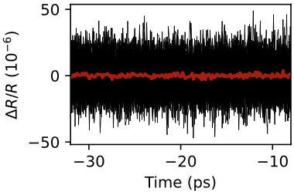
About noise
Black: 单次测量
Red：100次平均
N次测量平均的噪声
However
Not all noise in experimental measurements is unwelcome.
Certain fundamental noise sources contain valuable information about the system itself.

Slide 6
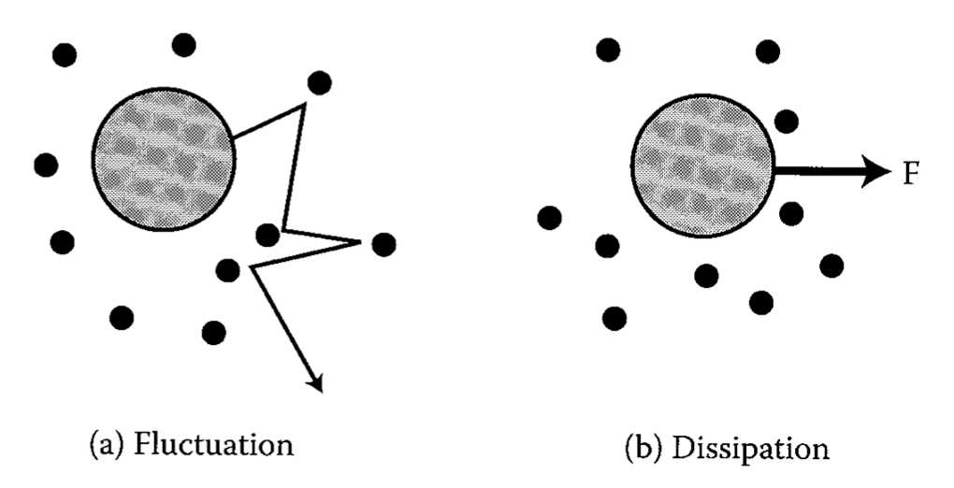
Fluctuation–dissipation theorem
When there is a process that dissipates energy, turning it into heat (e.g., friction), there is a reverse process related to thermal fluctuations.
Drag and Brownian motion
Resistance and Johnson noise
Notes:
quantifies the relation between the fluctuations in a system that obeys detailed balance and the response of the system to applied perturbations.
If an object is moving through a fluid, it experiences drag (air resistance or fluid resistance). Drag dissipates kinetic energy, turning it into heat. The corresponding fluctuation is Brownian motion. An object in a fluid does not sit still, but rather moves around with a small and rapidly-changing velocity, as molecules in the fluid bump into it. Brownian motion converts heat energy into kinetic energy—the reverse of drag.
If electric current is running through a wire loop with a resistor in it, the current will rapidly go to zero because of the resistance. Resistance dissipates electrical energy, turning it into heat (Joule heating). The corresponding fluctuation is Johnson noise. A wire loop with a resistor in it does not actually have zero current, it has a small and rapidly-fluctuating current caused by the thermal fluctuations of the electrons and atoms in the resistor. Johnson noise converts heat energy into electrical energy—the reverse of resistance.

Slide 7
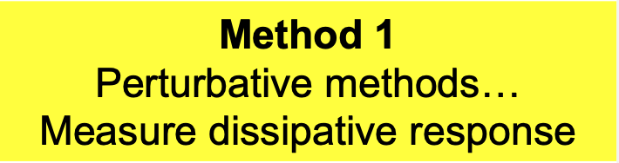
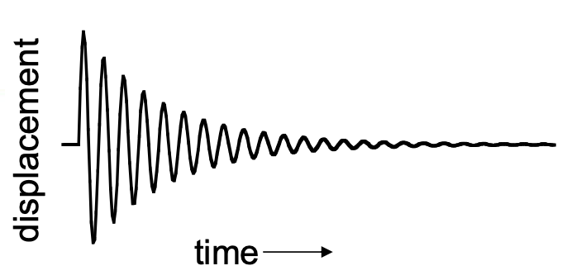
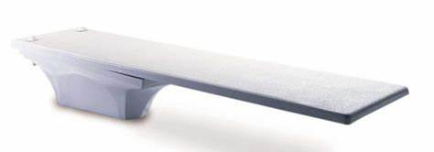
“Noise spectroscopy”: a simple example
Simple mechanical system: Cantilever (diving board)
What’s resonant frequency (ω₀)?
What’s ringdown time (Q)?
F

Slide 8
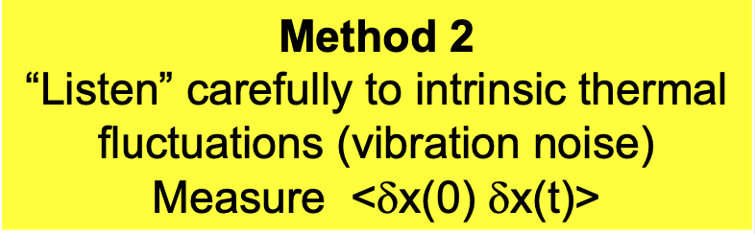
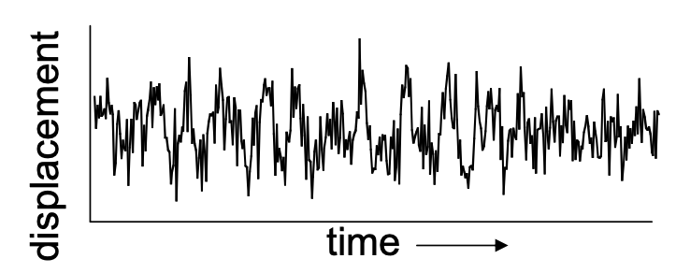

“Noise spectroscopy”: a simple example
Simple mechanical system: Cantilever (diving board)
What’s resonant frequency (ω₀)?
What’s ringdown time (Q)?

Slide 9
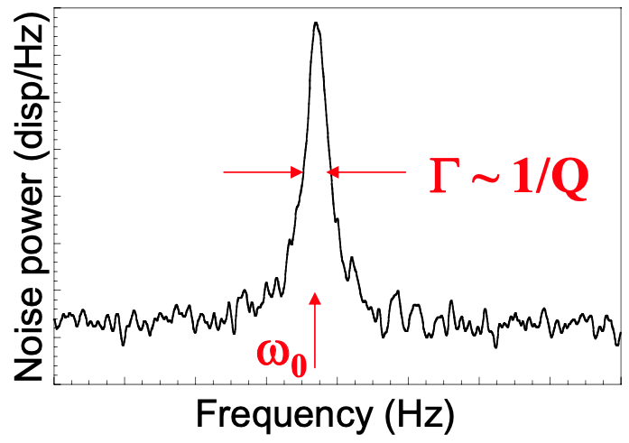
“Noise spectroscopy”: a simple example
Simple mechanical system: Cantilever (diving board)
What’s resonant frequency (ω₀)?
What’s ringdown time (Q)?

Slide 10
How to measure electron spin dynamics?
z
z
Method 1: Perturbative methods (e.g. optical pump-probe)
Method 2: Nonperturbative methods (e.g. optical spin noise spectroscopy)

Slide 11
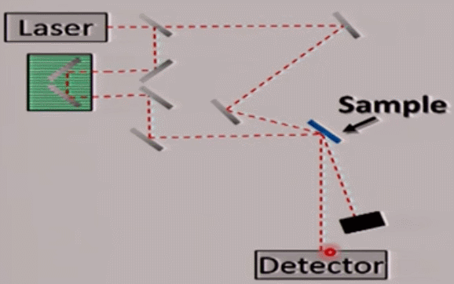
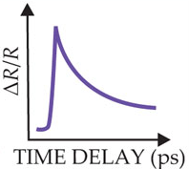
Ultrafast pump-probe spectroscopy
“Freeze” time on femtosecond timescales
Beam splitter
pump
Δt
Delay stage
probe
Transient reflectivity
Notes:
With the development of femtosecond laser systems the ultrafast time scales (below one nanosecond) are accessible, even in small laboratory experiments.

Slide 12
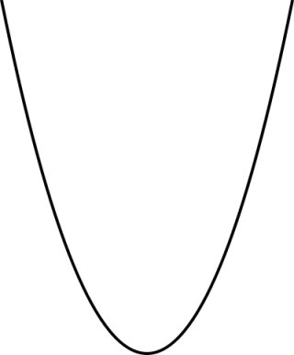
Optical spin orientation and
Faraday/Kerr rotation spectroscopy
E
Energy
α_{RCP}
α_{LCP}
n_{RCP}
n_{LCP}
RCP
LCP
k
0
0
0
Γ
0
Absorption
Index of refraction
pump
θ_{K}~ (n↑ - n↓)
Measure electron polarization

Slide 13
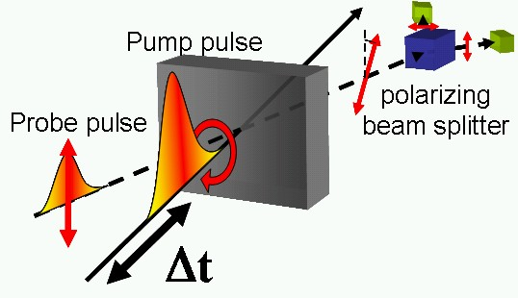
Inject spin polarization optically and measure its lifetime
S
Pump
Spin projection along k
Faraday rotation
Time delay
Notes:
光子有两种自旋态，方向是沿着光传播的方向，平行或反平行，左旋/右旋对应的角动量是正负1。

Slide 14
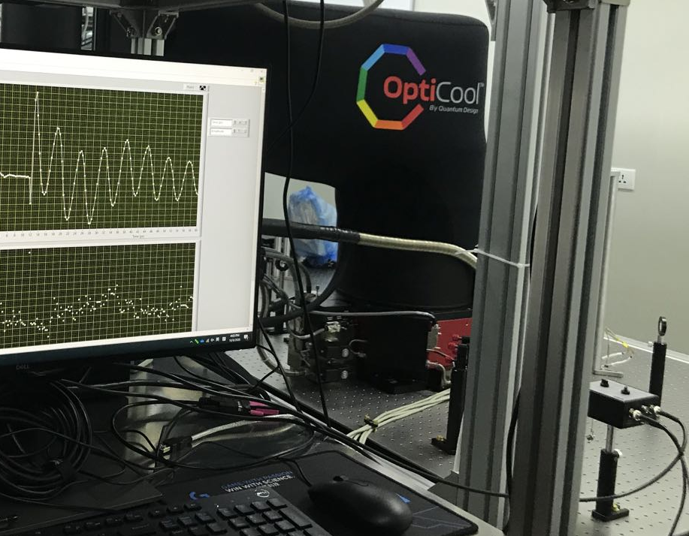
Inject spin polarization optically and measure its lifetime
Q: What would happen in a transverse magnetic field?
Larmor precession
S
B
Voigt geometry
Faraday rotation
Notes:
扭转力

Slide 15
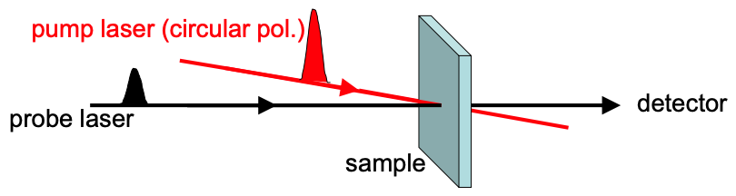
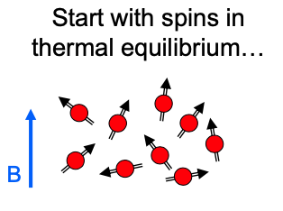
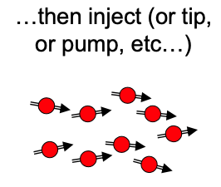
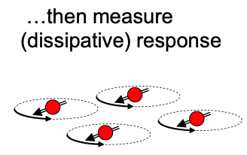
Inject spin polarization optically and measure its lifetime
Normally, spin dynamics revealed with spin-resonance (NMR, ESR),pump-probe optics: techniques are necessarily perturbative

Slide 16
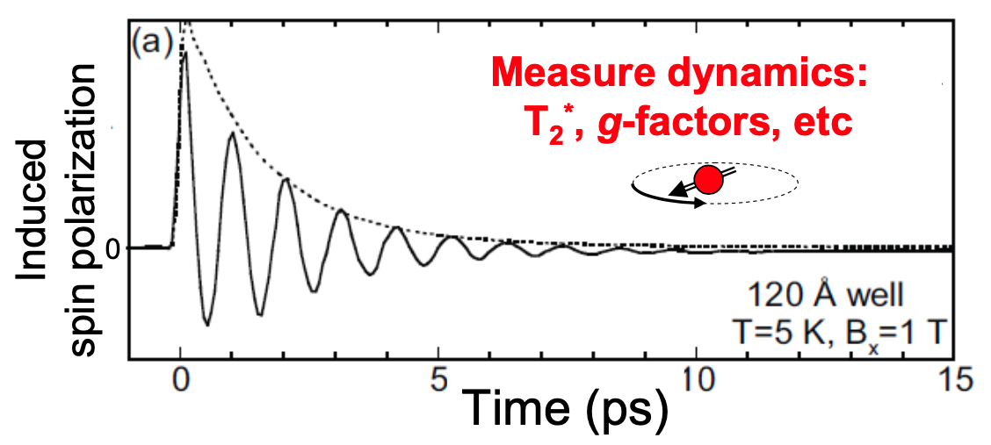

Inject spin polarization optically and measure its lifetime
Normally, spin dynamics revealed with spin-resonance (NMR, ESR),pump-probe optics: techniques are necessarily perturbative
Bloch equation

Slide 17
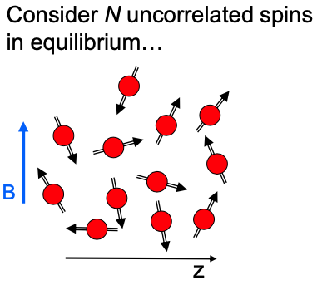
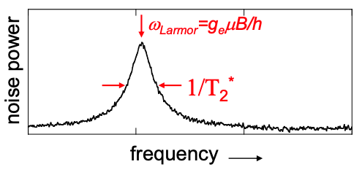

Dynamics also available via stochastic “spin noise”
Spectrum of correlations:
Dr. Scott Crooker

Slide 18
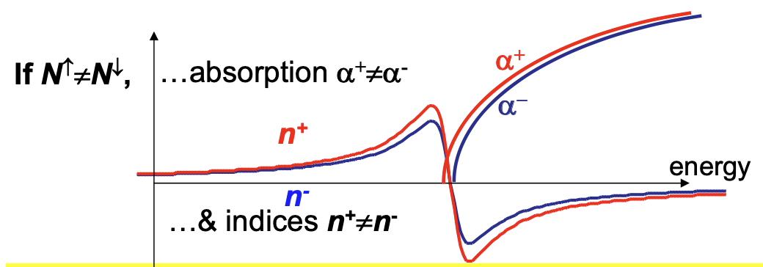
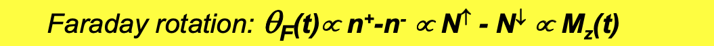
Nonperturbative measurement
Probe laser can be tuned far from absorption, but still measure spin via n⁺-n⁻
In this regard, it is “non-perturbing” probe

Slide 19
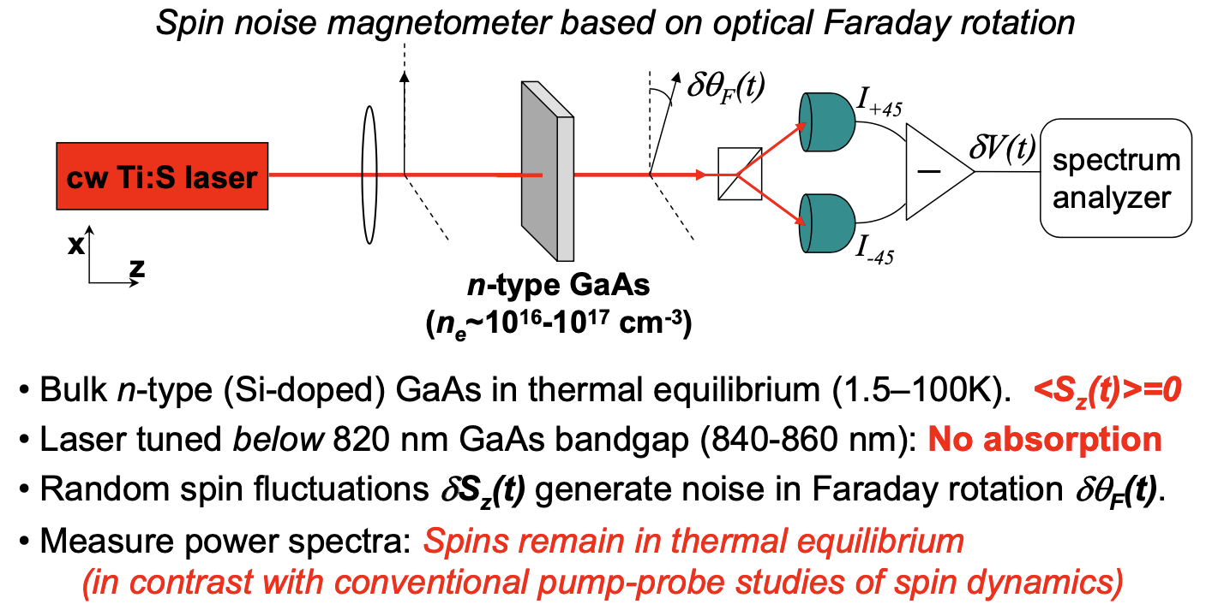
Experimental setup

Slide 20
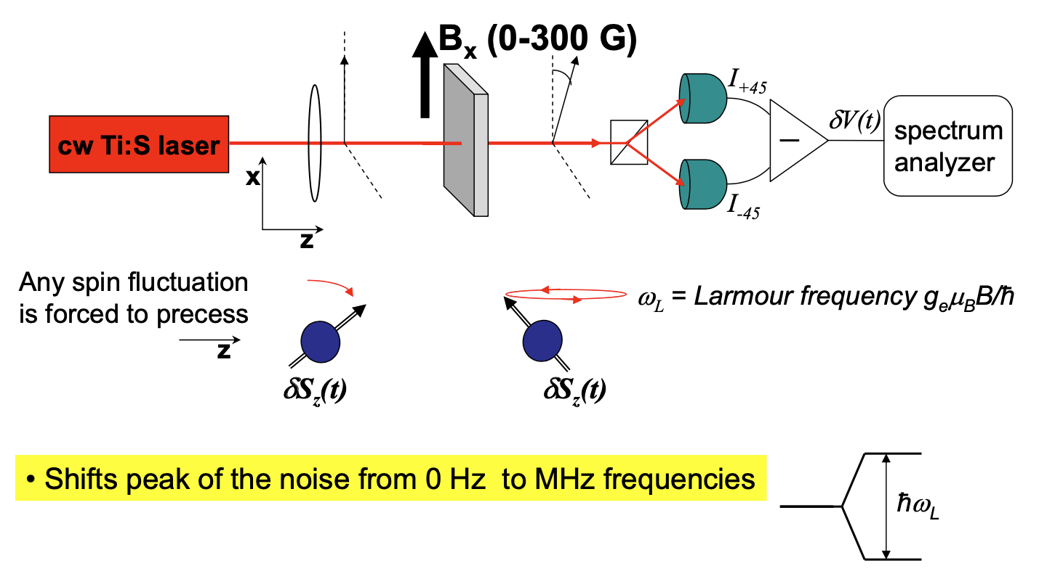
Experimental setup

Slide 21
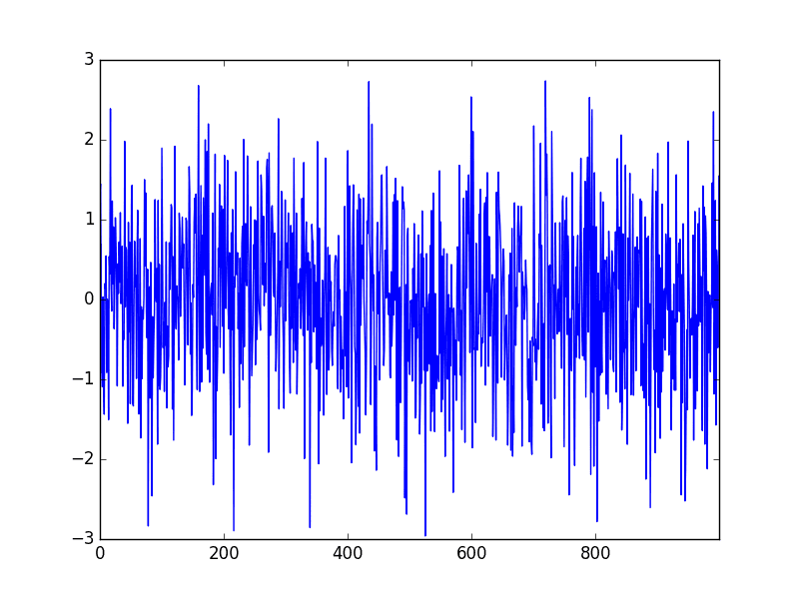



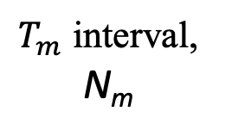

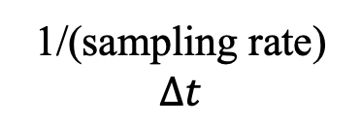
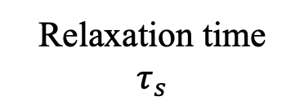

Measurements
$$T_{m}≫τ_{s}≫Δt$$
Relaxation time
$$τ_{s}$$
1/(sampling rate)
$$Δt$$
$$θ_{F}\left(t\right)$$
$$\sim S_{z}\left(t\right)$$
$T_{m}$ interval, N_{m}
average over i
require the calculation of ∼N_{m}² products

Slide 22

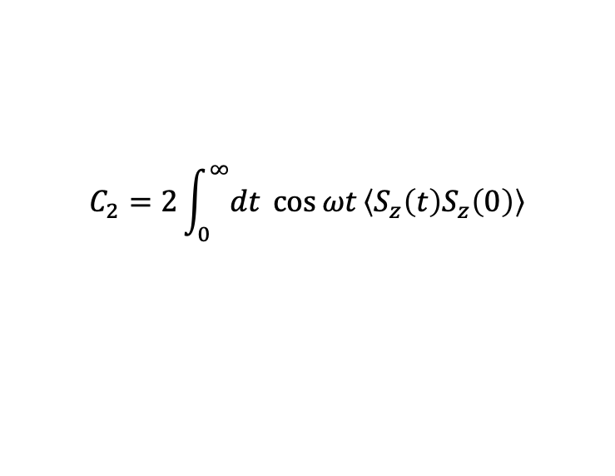
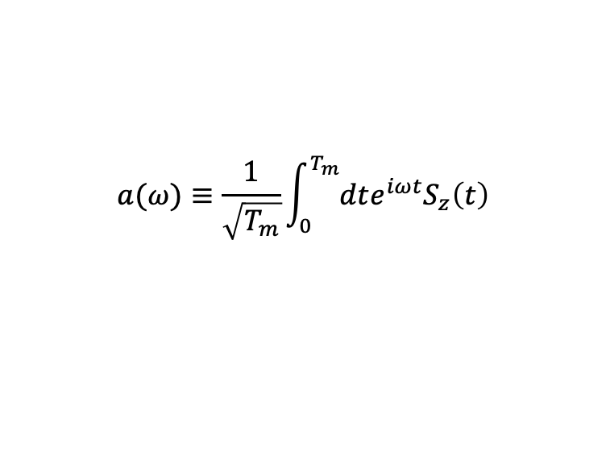
Noise power spectrum
$$a(ω)≡\frac{1}{\sqrt{T_{m}}}\int_{0}^{T_{m}}{dte^{iωt}S_{z}\left(t\right)}$$
Additivity: the contributions from independent noise sources add to each other.
power spectrum
Scales as ~N_{m}
Wiener–Khinchine theorem: in the steady state, the noise power spectrum and the spin–spin correlator are related by the Fourier transform:
$$C_{2}=2\int_{0}^{∞}{dt \cos{ωt}\left\langle S_{z}\left(t\right)S_{z}\left(0\right)\right\rangle }$$
autocorrelation

Slide 23
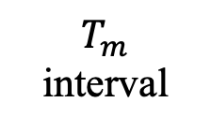

Measurements
$$T_{m}≫τ_{s}≫Δt$$
Relaxation time
$$τ_{s}$$
1/(sampling rate)
$$Δt$$
$$θ_{F}\left(t\right)$$
$$\sim S_{z}\left(t\right)$$
$$…$$
F.T. spectrum
F.T. spectrum
F.T. spectrum
$$T_{m}$$
interval
average over all results

Slide 24
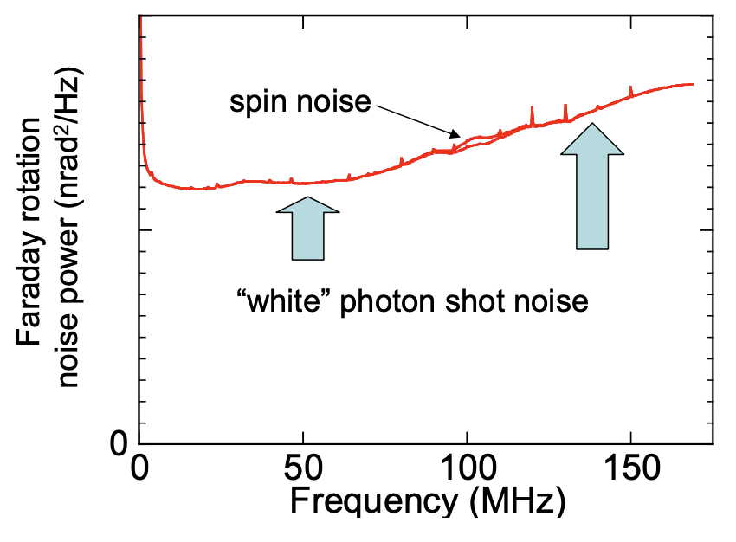
Spin noise in n-GaAs
Spin noise signals are small! 10-1000x less than photon shot noise (nanoradians/√Hz)
Additivity: the contributions from independent noise sources add to each other.
PRB 79, 035208 (2009)

Slide 25
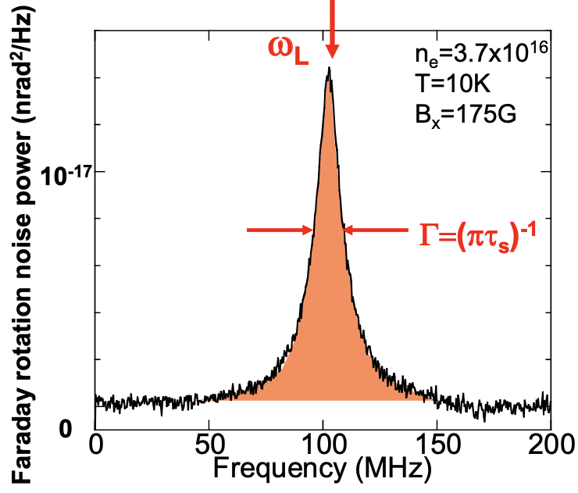
Spin noise in n-GaAs
PRB 79, 035208 (2009)

Slide 26
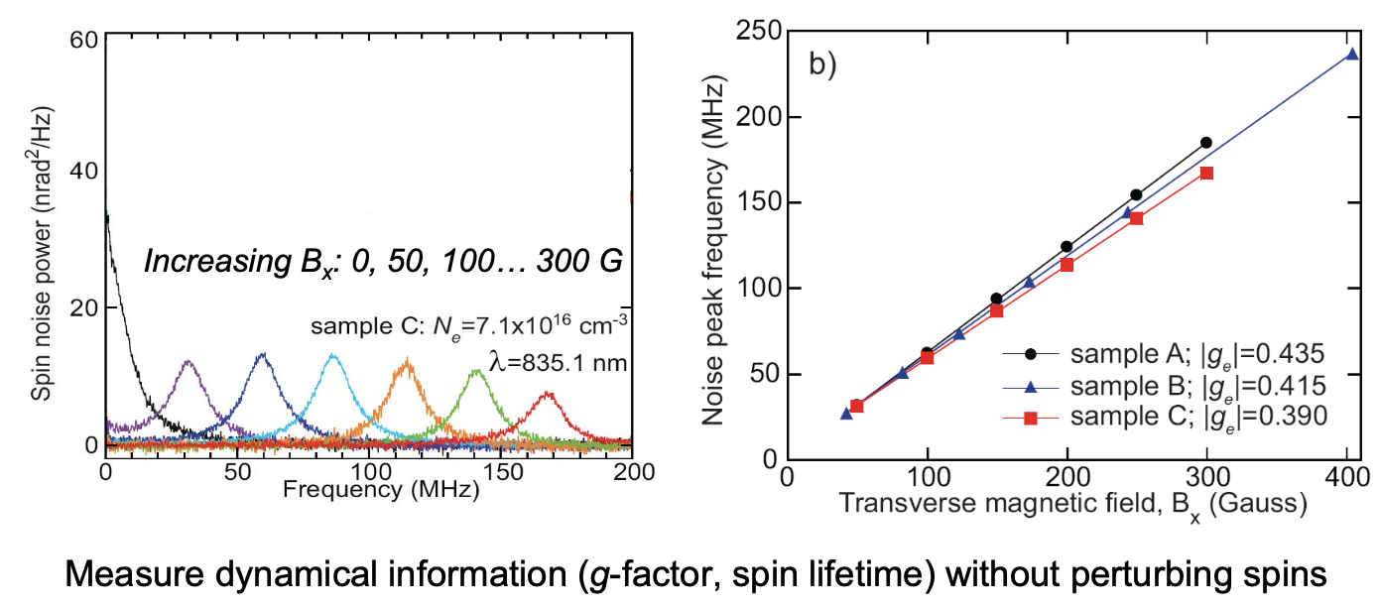
Spin noise in n-GaAs
PRB 79, 035208 (2009)

Slide 27
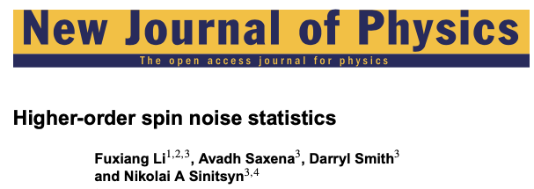



Slide 28
References
GaAs: PRB 79, 035208 (2009)
Alkali atomic gas (K, Rb, Cs): Nature 431, 79 (2004)
InGaAs quantum dots: PRL 108, 186603 (2012)
Two-color spin noise: Nat. Commun 5, 4949 (2014); Sci. Rep. 5, 9573 (2015)
Higher-order spin noise: New. J. Phys. 15, 113038 (2014)
Review: Rep. Prog. Phys 79, 106501 (2016)

Slide 29
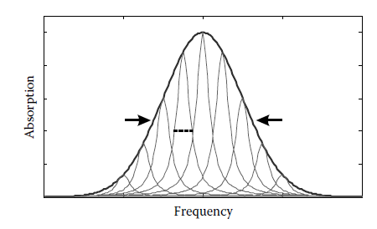
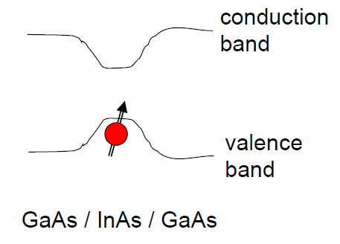

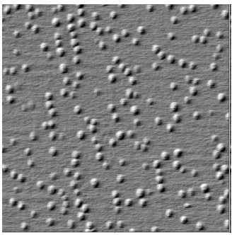
Inhomogeneous and homogeneous linewidths of self-assembled QDs
The homogeneous linewidths are inaccessible by conventional linear optical spectroscopies.
New technique: 2-color SNS to probe below the inhomogeneous broadening.
LINEAR technique!
Notes:
10^10 /cm^2 x20L 10% hole

Slide 30
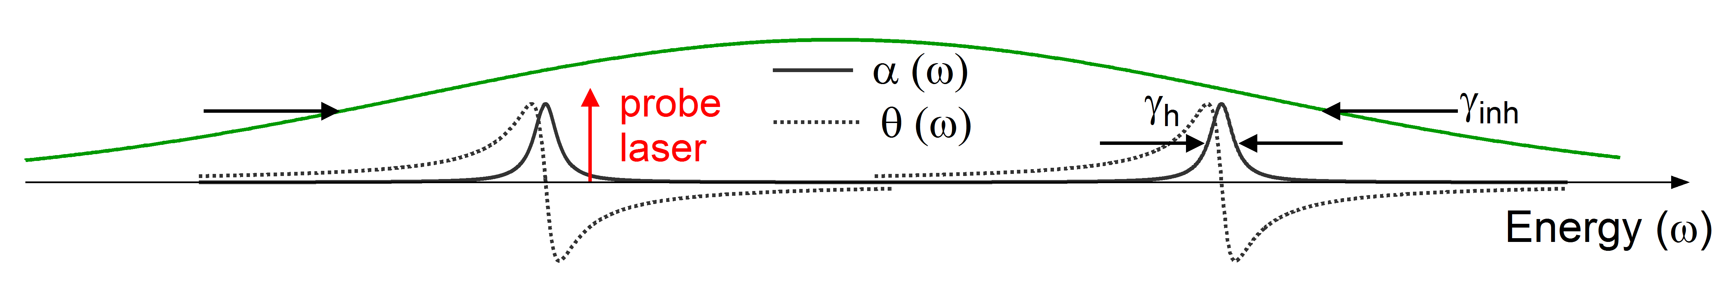
Spin noise in InGaAs quantum dots with a single probe
QD A
QD B
The laser is very sensitive to fluctuations on Dot A, but not sensitive to fluctuations on Dot B.
PRL 104, 036601 (2010), PRL 108, 186603 (2012).

Slide 31
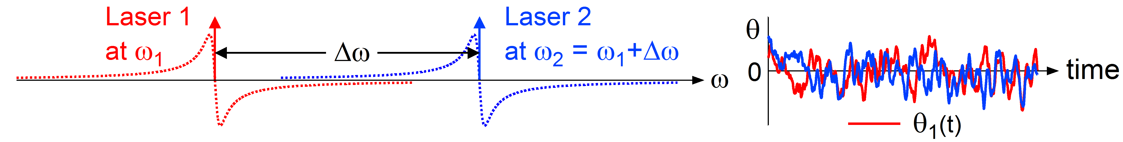
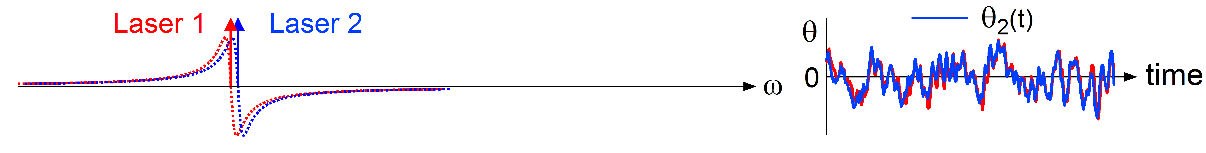
2-color spin noise spectroscopy
The FR variance (i.e., the measured FR noise power):
Different dots: Uncorrelated noise, add incoherently.
Same dots: Correlated noise, add coherently!

Slide 32
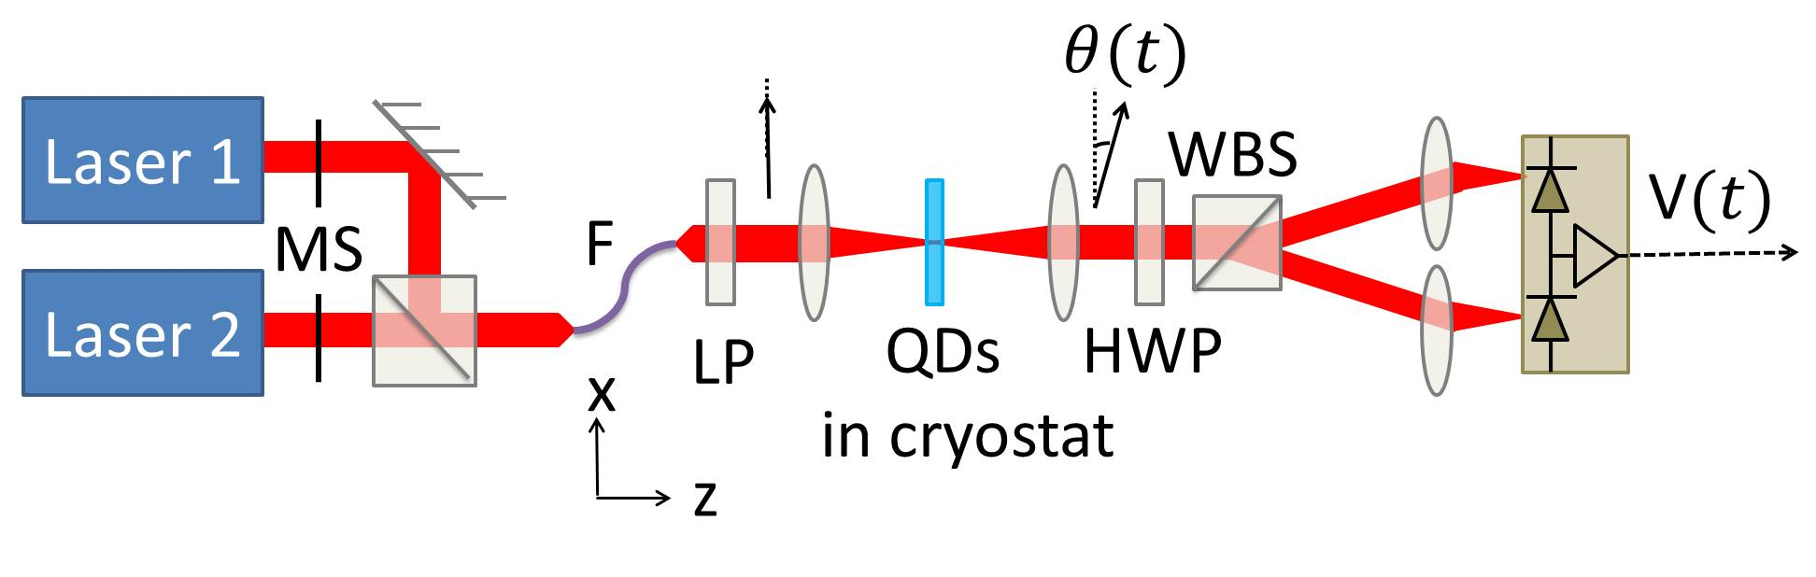
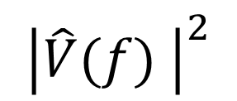
2-color spin noise setup
F.T.
$${\left|\hat{V}(f) \right|}^{2}$$

Slide 33
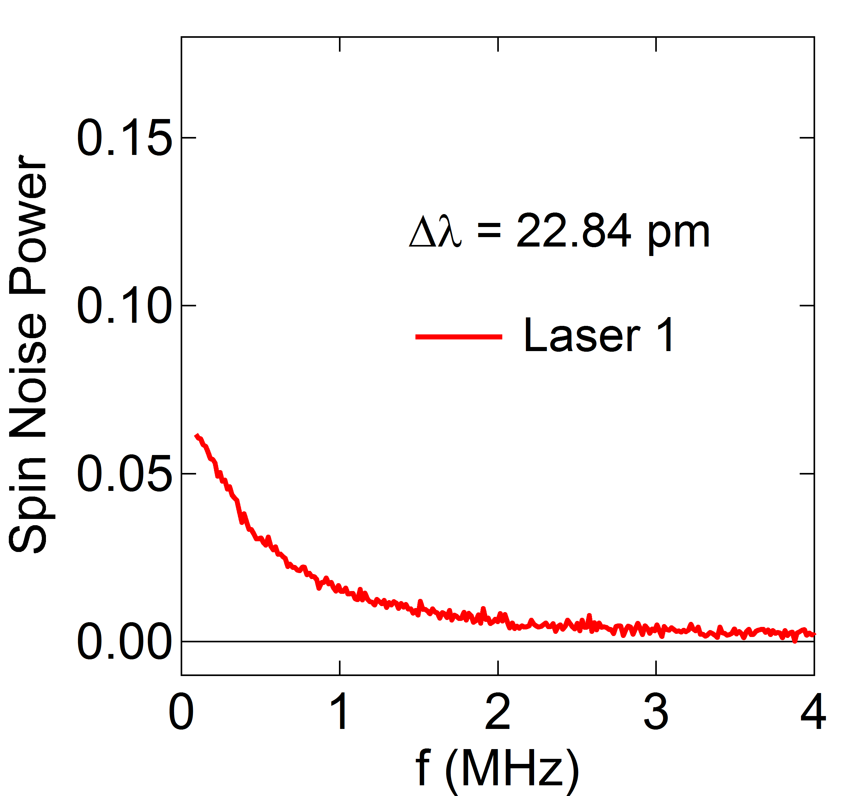
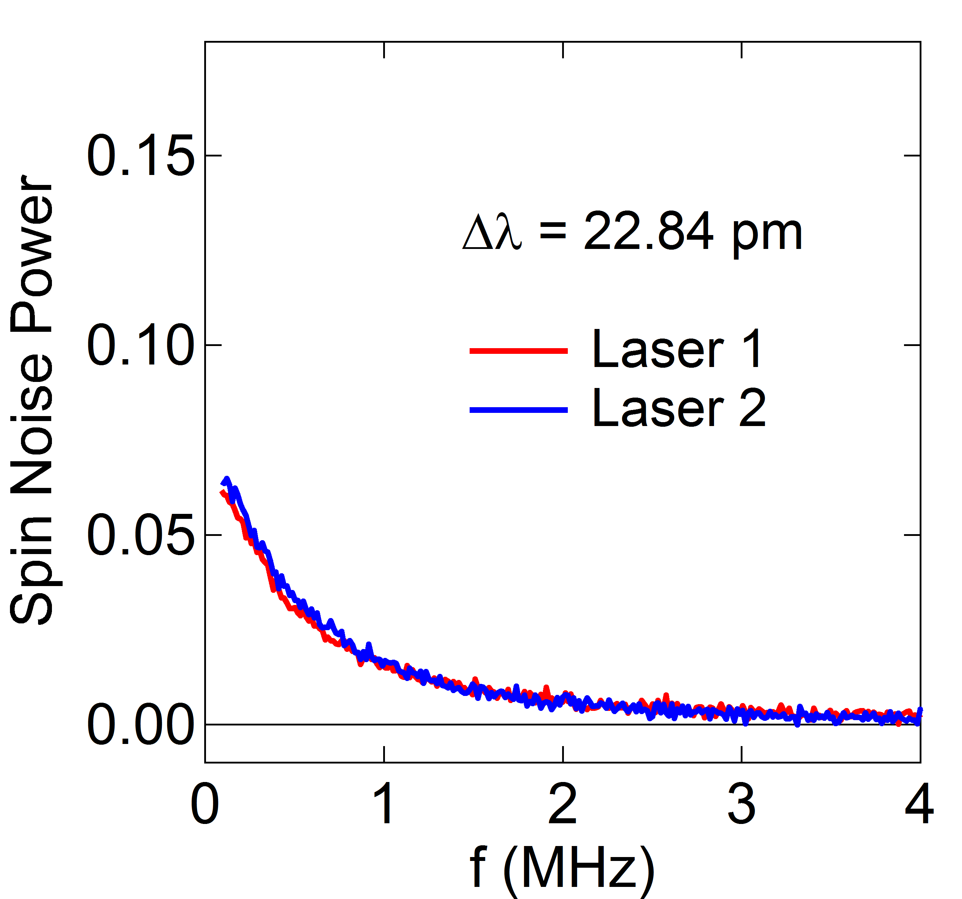
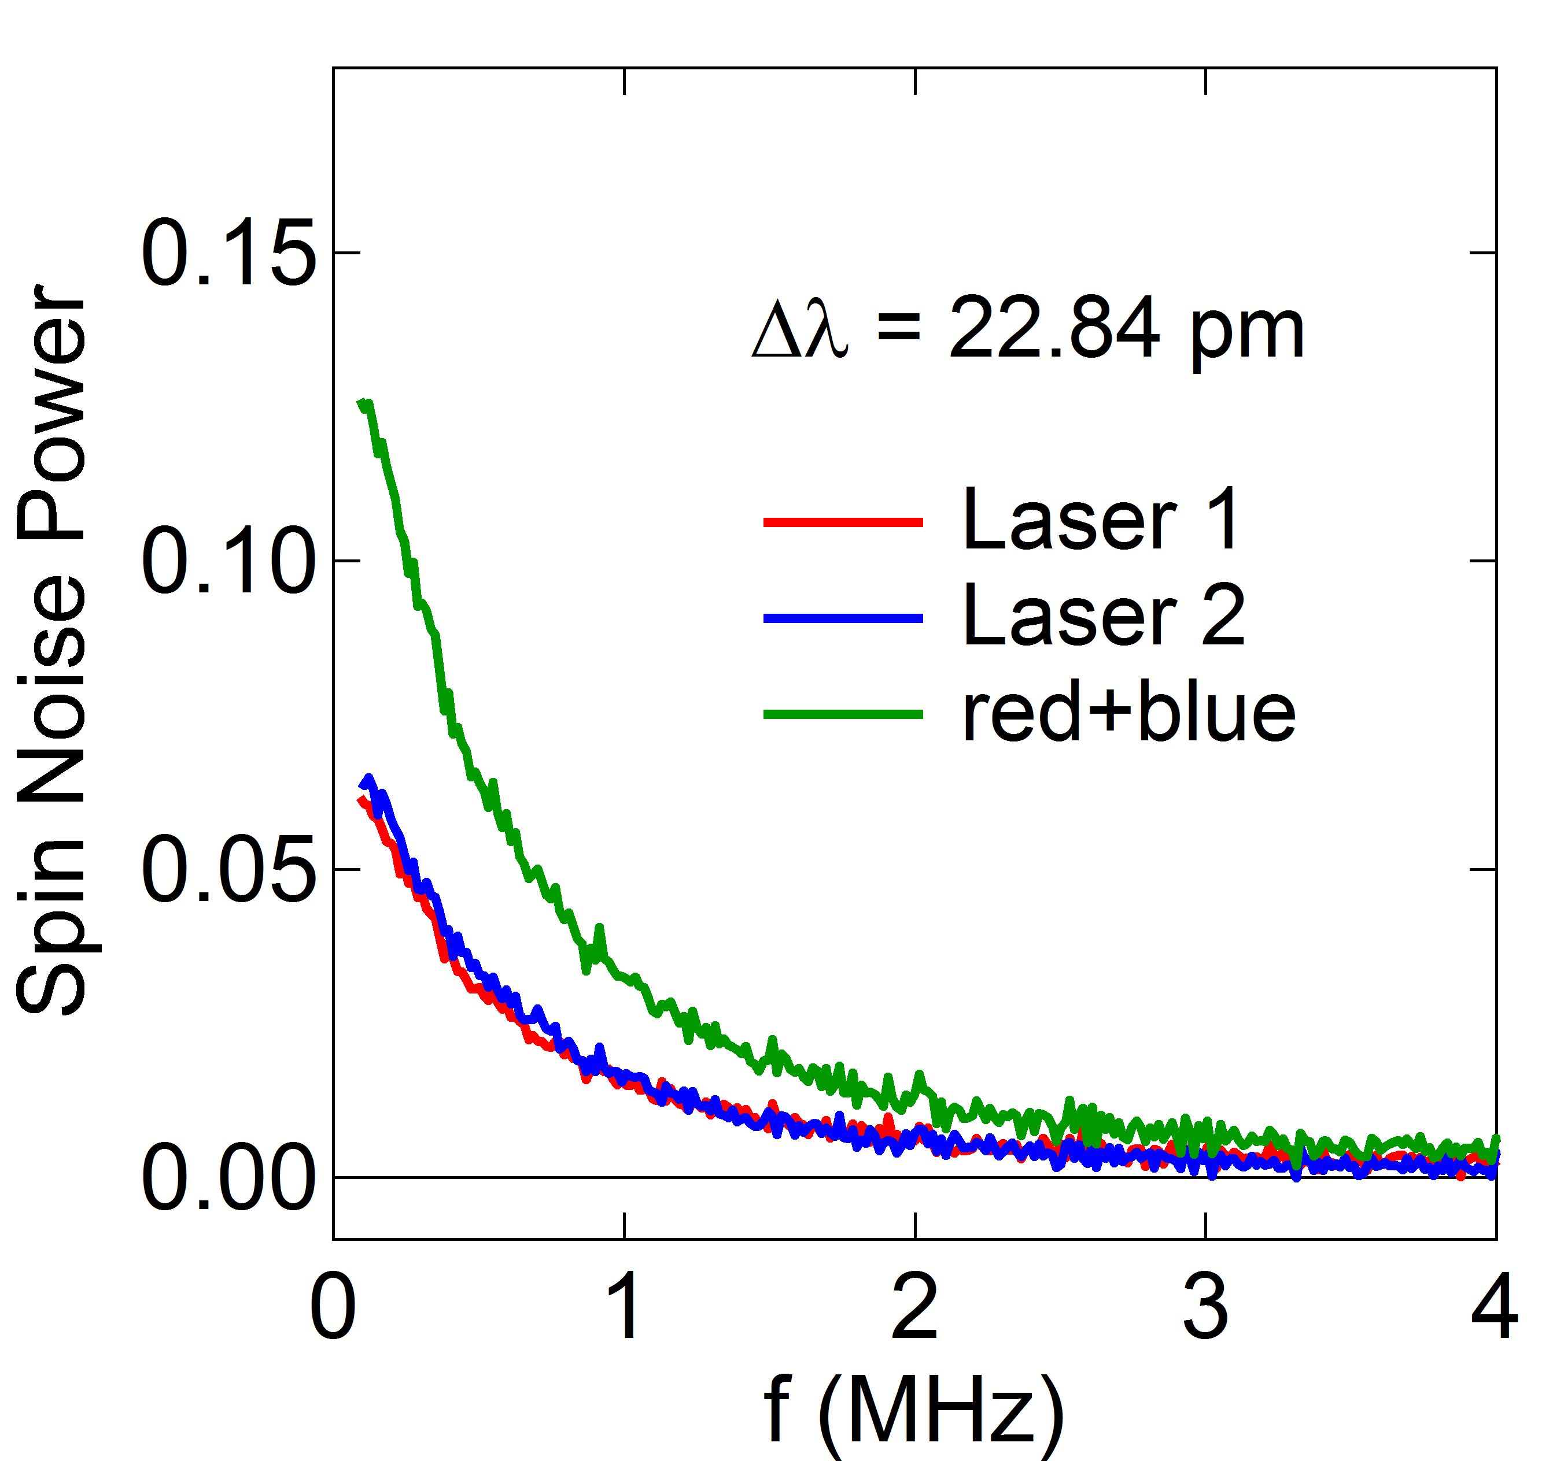
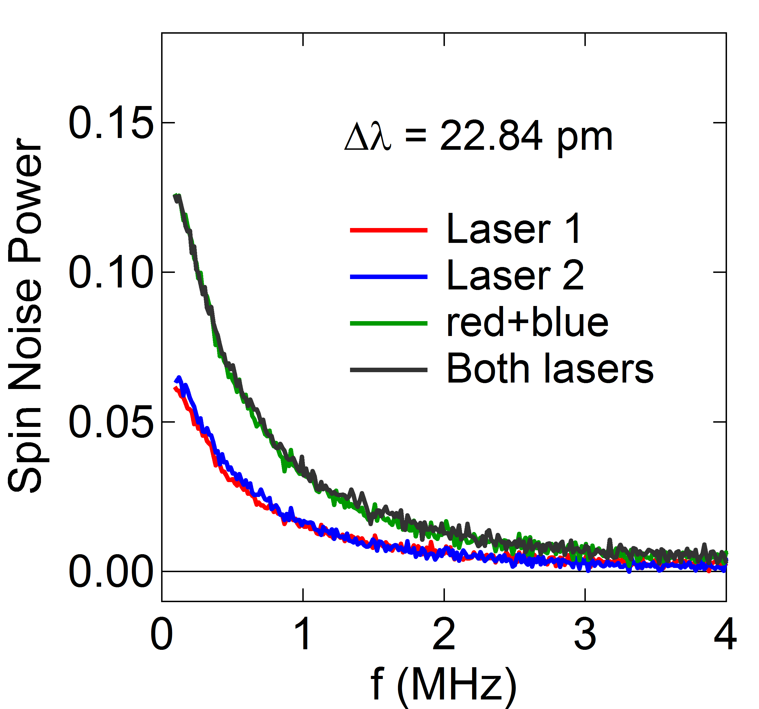






2-color SNS measurements
Uncorrelated, noise signals add incoherently
Correlated, noise signals add coherently
Notes:
1pm = 1.5ueV = 375 MHz @900nm, 500kHz -> 300ns

Slide 34





2-color spin noise correlator
Uncorrelated
Correlated
Correlated
Uncorrelated
The correlator has a Lorentzian line shape, and its HWHM is the homogeneous linewidth.

Slide 35


Laser intensity dependence
gamma_h increases with the intensity due to the resonant QD pumping effects and excitation-induced broadening.

Slide 36


Temperature dependence
gamma_h broadens with increasing temperature in QDs due to interactions with phonons.

Slide 37



Control experiment on bulk n-GaAs
Correlator is independent of detuning.
Notes:
3.7x10^16/cm^3

Slide 38



Noise power spectrum
$$a(ω)≡\frac{1}{\sqrt{T_{m}}}\int_{0}^{T_{m}}{dte^{iωt}S_{z}\left(t\right)}$$
Additivity: the contributions from independent noise sources add to each other.
power spectrum
Scales as ~N_{m}
Wiener–Khinchine theorem: in the steady state, the noise power spectrum and the spin–spin correlator are related by the Fourier transform:
$$C_{2}=2\int_{0}^{∞}{dt \cos{ωt}\left\langle S_{z}\left(t\right)S_{z}\left(0\right)\right\rangle }$$
autocorrelation
Cross-correlation
spin densities with different indexes

Slide 39




Two-color SNS to reveal spin interactions in multi-component spin systems
Faraday rotation
$$λ_{Rb}$$
$$λ_{Cs}$$
D1 transition
795nm
895nm

Slide 40




Experimental setup
Spin noise power spectra
Cross-correlation spectra
F.T.
$${P_{α}=\left|{\hat{S}}_{α}(ω) \right|}^{2}$$
$${{{P_{cr}\left(ω\right)=\hat{S}}_{Rb}}^{∗}(ω)\hat{S}}_{Cs}(ω)$$
$$(α=Rb,Cs)$$

Slide 41








Spin noise power spectra and
cross-correlation spectra
arXiv:1408.5399
F.T.
F.T.
$$\left\langle S_{α}\left(t\right)S_{α}\left(0\right)\right\rangle$$
$$\left\langle S_{Rb}\left(t\right)S_{Cs}\left(0\right)\right\rangle$$
$${P_{α}=\left|{\hat{S}}_{α}(ω) \right|}^{2}$$
$${{{P_{cr}\left(ω\right)=\hat{S}}_{Rb}}^{∗}(ω)\hat{S}}_{Cs}(ω)$$
$$(α=Rb,Cs)$$

