Slide 1
噪声谱 第二阶段
3. Aug, 2023
吴致颉

Slide 2
Temporal Response
$$x\left(t\right)$$
$$y\left(t\right)$$
Correlation
$$R$$
$$y\left(t\right)=\int{dτ_{1} R^{\left(1\right)}\left(t−τ_{1}\right)x\left(τ_{1}\right)}$$
$$C_{2}\left(τ\right)≡{\left\langle y\left(t\right)y\left(t+τ\right)\right\rangle }_{t}$$
$$+\int{dτ_{1}dτ_{2}R^{\left(2\right)}\left(t−τ_{1}, t−τ_{2}\right)x\left(τ_{1}\right)x\left(τ_{2}\right)}$$
$$+…$$
$$C_{3}\left(τ_{1},τ_{2}\right)≡{\left\langle y\left(t\right)y\left(t+τ_{1}\right)y\left(t+τ_{2}\right)\right\rangle }_{t}$$
$$…$$
Spectral Response
Spectrum
$$y\left(ω\right)=R^{\left(1\right)}\left(ω\right)x\left(ω\right)$$
$$S_{2}\left(ω\right)≡FT\left\{C_{2}\left(τ\right)\right\}={\left|y\left(ω\right)\right|}^{2}$$
$$+R^{\left(2\right)}\left(ω_{1},ω_{2}\right)x\left(ω_{1}\right)x\left(ω_{2}\right)$$
$$+…$$
$$S_{3}\left(τ_{1},τ_{2}\right)≡FT\left\{C\left(τ\right)\right\}=y{\left(ω_{1}+ω_{2}\right)}^{∗}y\left(ω_{1}\right)y\left(ω_{2}\right)$$
$$…$$
(bispectrum)
Notes:
Fluctuation dissipation theorem

Slide 3
3rd order correlation function $↔$ bispectrum
$$S_{3}=y{\left(ω_{1}+ω_{2}\right)}^{∗}y\left(ω_{1}\right)y\left(ω_{2}\right)$$

Slide 4
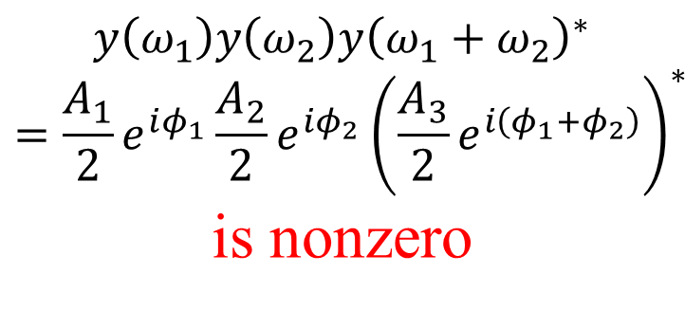
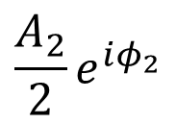
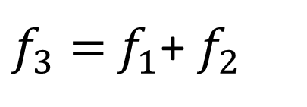
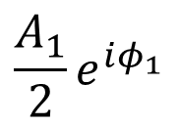
3rd order correlation function $↔$ bispectrum
$$S_{3}=y{\left(ω_{1}+ω_{2}\right)}^{∗}y\left(ω_{1}\right)y\left(ω_{2}\right)$$
3 $A_{i}\sin\left(2πf_{i}t+φ_{i}\right), i=1,2,3$
$$f_{1}+f_{2}=f_{3}$$
$$φ_{1}+φ_{2}=φ_{3}$$
Note: such phase info is completely lost in $S_{2}={\left|y\left(ω\right)\right|}^{2}$
$${\frac{A_{1}}{2}e}^{iφ_{1}}$$
$${\frac{A_{2}}{2}e}^{iφ_{2}}$$
$\frac{A_{3}}{2}e^{iφ_{3}}$= $\frac{A_{3}}{2}e^{i\left(φ_{1}+φ_{2}\right)}$
$$y\left(ω_{1}\right)y\left(ω_{2}\right)y{\left(ω_{1}+ω_{2}\right)}^{∗}=\frac{A_{1}}{2}e^{iφ_{1}}\frac{A_{2}}{2}e^{iφ_{2}}{\left(\frac{A_{3}}{2}e^{i\left(φ_{1}+φ_{2}\right)}\right)}^{∗}$$
is nonzero
$$f$$
$$0$$
$$f_{1}$$
$$f_{2}$$
$f_{3}=$ $f_{1}$+ $f_{2}$
Notes:
“Quadratically Phase Coupled” signals ~ nonlinear optics
However, if f1+f2!=f3, or the three components are not coherent, the correlator is 0
➔ Reflects the information of the relation of different frequency components

Slide 5
Stochastic Models for Time Series Analysis
$$ε_{t}$$
$$X_{t}$$
Moving Average model (MA)
$X_{t}$ depends on history of external noise
Autoregressive model (AR)
$X_{t}$depends on its history
Autoregressive-Moving-Average model (ARMA)
$X_{t}$depends on both
Notes:
“parametric” methods: construct a model out of thin air and fit the process to the coefficients
Range of correlation:
MA: finite
AR: infinite!!!

Slide 6
Autoregressive-Moving-Average model (ARMA)
generate dataset
Task
recover the coefficients $φ_{1},…,φ_{p},θ_{1},…θ_{q}$
3rd correlation involved
algorithms
e.g. Double $C_{3}(q, k)$ formulas
Mendel, J. M. (1991). Proceedings of the IEEE, 79(3), 278–305. https://doi.org/10.1109/5.75086
linear model, yet is able to approximate complicated processes!
Notes:
All physics would be encoded in the coefficients
How to interpret them??

Slide 7
bonus
How are the coefficients related to physical parameters? (e.g. information of interaction between spins…)
better algorithms than Double $C_{3}(q, k)$ Formulas

